Slide 1
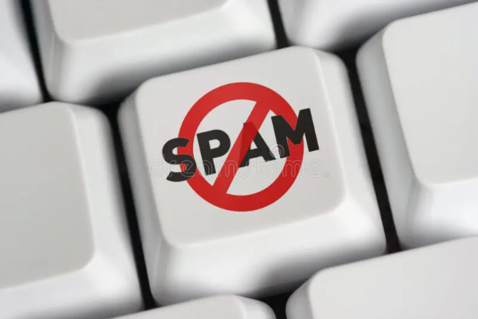

Email Spam Filter
Presented By:
Name: R. Purnima
Course: Artificial Intelligent
Subject: Machine Learning
Date : 06-03-2026

Slide 2
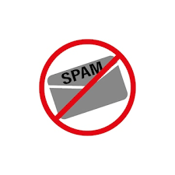
Introduction
Email Spam Filter is a system that automatically detects unwanted or harmful emails and moves them to the spam folder.
Spam emails include advertisements, scams, and phishing messages.
Spam filters help protect users from unwanted emails.
Spam Email:
Spam emails are unwanted messages sent to many people, usually for advertising or promotion.
Phishing Email:
Phishing emails are fake messages that pretend to be from trusted organizations to steal sensitive information such as passwords or bank details.
Example: Emails from unknown senders promoting fake offers.
Notes:
Email is an important communication tool used by people and organizations. However, many emails we receive are unwanted or harmful. These emails are called spam. Spam filters help identify and block such emails.

Slide 3
What is Spam Email?
Spam emails are unwanted messages sent in bulk.
Common types:
Advertisement emails
Fake lottery messages
Phishing emails
Malware links
Example: “Congratulations! You won ₹10,00,000. Click here to claim.”
Notes:
Spam emails are unwanted messages sent to a large number of users. These emails usually contain advertisements, fake offers, or promotions.

Slide 4
Why Spam Filtering is Important?
Spam filters help to:
Reduce unwanted emails
Protect users from scams
Save time
Improve email security
Without spam filters, inboxes would be filled with useless emails.
Notes:
Spam filtering is important because it protects users from fraud and cyber attacks. It also helps keep inboxes clean and saves time.

Slide 5
How Email Spam Filter Works?
Spam filters use Machine Learning algorithms.
Steps:
Collect email data
Analyze email content (words, links, sender)
Train a machine learning model
Classify email as:
Spam
Not Spam
Notes:
Spam filters work by analyzing email content such as words, links, and sender information. Machine learning models are trained to classify emails as spam or not spam.

Slide 6
Diagram: How Email Spam Filter Works
Incoming Email
↓
Email Received
↓
Content Analysis
(check words, links, sender)
↓
Machine Learning Model
(Spam Detection)
↓ ↓
Spam Not Spam
↓ ↓
Spam Folder Inbox
Notes:
When an email is received, the spam filter first analyzes the content of the email such as words, links, and sender information. Then a machine learning model checks whether the email contains suspicious patterns. If it detects spam characteristics, the email goes to the spam folder. Otherwise, it goes to the inbox.

Slide 7
Example of Spam Detection
Machine learning checks words like:
“Free”
“Win money”
“Offer”
“Click here”
If many suspicious words appear, the email is marked as spam.

Slide 8
Algorithms Used
Some common algorithms:
Naive Bayes
Logistic Regression
Decision Tree
Random Forest
These algorithms help classify emails.
Notes:
Several machine learning algorithms can be used to detect spam emails. Some common algorithms include Naive Bayes, Logistic Regression, Decision Trees, and Random Forest.

Slide 9
Advantages
Protects users from fraud
Keeps inbox clean
Saves time
Improves security
“Spam filters in email services like Gmail use machine learning models trained on millions of emails to detect spam and phishing attacks.”
Notes:
Spam filters help protect users from cyber threats and keep inboxes organized. They also improve the overall email experience.

Slide 10
Conclusion
Content:
Spam filters are an important application of machine learning
Help detect unwanted and harmful emails
Improve online security
“Future of Spam Detection using AI”
Notes:
In conclusion, email spam filters play an important role in protecting users from unwanted and harmful messages. Machine learning makes spam detection more accurate and effective.

